Slide 1
Introduction to Transmedia
Linear storytelling is dead! Long live world building?

Slide 2
There’s Never Been a More Exciting Time to be a Storyteller
Why?
New platforms and new business models are emerging
An entire new menu of affordable storytelling platforms can turn everyone into a published storyteller!
TRANSMEDIA IS ABOUT MERGING ALL THOSE PLATFORMS INTO ONE COHESIVE WORLD WITH LOTS OF SUBSTORIES WITHIN THAT WORLD

Slide 3
Cultural and Media Gatekeepers are Falling…
(Finish the sentence)
…and they can’t get up
…and they’re tearing down all the old media walls
…proving they just don’t make things as well as they used to
…and you’d better have a damn good lawyer

Slide 4
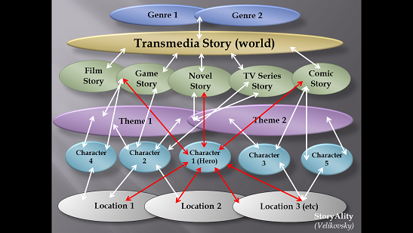
You’re at the Beginning of a New Form of Storytelling

Slide 5
The Power of Transmedia
Any single-medium story can move an audience, but
…can it make an audience feel directly involved in the events in that story?
…can it build and hold an audience?

Slide 6
Audience Expects More
They want richer, deeper stories, and, they want to feel more involved.
They want popcorn to taste like popcorn, not cardboard crap.
George Clooney and Brad Pitt set to star in “Ocean’s 23.”
TRANSMEDIA DELIVERS!

Slide 7
Businesses Want More, Too
HBO, Disney, Sony, et al, have begun creating Transmedia experiences for the projects, inviting greater audience engagement
GREATER PROFITS!
Stadiums named after them!

Slide 8
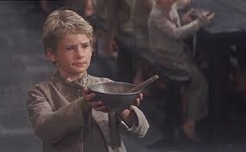
Hey EVERYONE…Let’s Do Some Transmedia
“Please, sir…I want more…more transmedia.”

Slide 9
Introducing…

Slide 10
We All Know the Story
Jack and Jill went up the hill To fetch a pail of water. Jack fell down and broke his crown, And Jill came tumbling after.
Up Jack got, and home did trot, As fast as he could caper, He went to bed to mend his head, With vinegar and brown paper

Slide 11
But, What Do We Know About Jill and Jill?
They went up the hill to fill a pail with water.
Jill has an eating disorder…she eats dinner at breakfast time, lunch at night, and supper at noon?
Jack longs for a yoyo?
Jill’s visited every night by a spirit named Herman?
Jack is saving for a pair of Air Jordan’s?
Really, we know nothing about them.

Slide 12
This is the Problem with a Single Medium Story
There’s a beginning, middle and end
But, what happened to Jack and Jill before the beginning of the poem?
What happened to them after the poem ended?
What was the mother doing with the man next door while Jack and Jill were going up the hill?
What’s the deal with the father?

Slide 13
Fortunately, No One Owns the Rights to “Jack and Jill”
So, we can use the nursery rhyme as our introduction to Jill (or Jack, too, for that matter)…and Transmedia (adaptive transmedia)!

Slide 14
First, We Establish Our Objectives for our Transmedia Experience
Why do we want to do it?
To monetize the experience
To build audience for an upcoming feature, TV or cable movie, or TV/cable series
To simply give lovers of the story a richer and deeper experience

Slide 15
We’ll Assume for the Purposes of this Presentation…
It’s to give nursery rhyme lovers of the story a richer, deeper and even more participatory experience!
And, our audience is adults 18-34.

Slide 16
Transmedia allows us to know – and do– more

Slide 17
Thanks to Today’s Proliferation of Social Media…
We can deliver on our objective.
We can deliver to our audience.
In the words of the famed transmedia professor, Larry Weiner, we put “more meat on the story’s bones.”
He also says, “Who’s getting the coffee?”

Slide 18
What is Transmedia Anyway?
Transmedia means telling a story via several different media platforms. However, this does not mean that the story is just ‘displaced’ from one platform to the next, such as simply adapting a novel into movie. True transmedia stories use each platform to add something new to the overall narrative, be it by offering background stories, changing the perspective on an event or character through different viewpoints, or continuing a story arch that was left off in another medium.
Christine Weibrecht

Slide 19
So, How Crazy Can We Get with Transmedia?
Because no one holds the copyright to the story of Jack and Jill, we can get as crazy as we want…as long as it makes sense.
So, for the sake of giving an example of Transmedia, let’s get really crazy.

Slide 20
Let’s Meet Our Protagonists

Slide 21
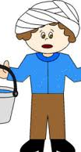
Jack
Name: Jack
Aged: 13
Hobbies: Boy scouts, yodeling, 4-H clubbing, camping, yoyos, spending time alone in his room with the door locked, with strange sounds coming from behind the door.
Personality asset: Duller than rust

Slide 22
What Social Media Can We Use to Help Us Learn About Jack?
Twitter?
Facebook?
Instagram?
Snapchat?
Pinterest?
Tik Tok
What’s all that crap? All I know is two paper cups and string!”

Slide 23
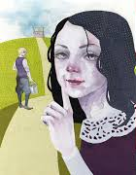
Meet Jill
Name: Jill
Age: 12
Hobbies: Witchcraft, ESP, LSD, Jack Daniels, Mike’s Hard Lemonade, cheerleading
Personality asset: Can wrap men around her little finger…and she knows it!

Slide 24
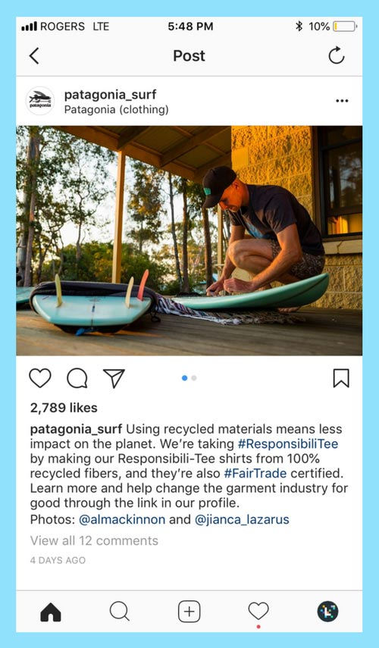
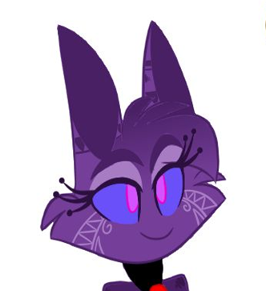
We Can Use the Same Social Media Platforms We Used for Jack!
Jill_nurseryrhyme
Jill_nurseryrhyme Everyone’s asking me why Jack and I went up the hill #JackandJillupthehill. We told Mom it was to fetch a pail of water, but that was a lie. We really went up the hill because we met a really strange man who said he knew who our father was. #Where’sDad

Slide 25
Meet the Mother
Name: Sophie
Age: 45
Hobbies: beating kids, drinking rot gut whiskey from the bottle, piercings, smoking hemp
Personality asset: Falls down when drunk

Slide 26
How About the Father? Who is He? Where is He?
Is he the mysterious man Jack and Jill met on the other side of the mountain?
Did he die?
Did he leave Sophie?
Is he away with the military?

Slide 27
Turns Out…
Sophie is a welder (she has a website: www.sophie’sironworks.com), and she puts her designs on Pinterest and Instagram.
And, on a recent facebook post, she lamented about a failed botox injection.
After Jill was born, a crazy neighbor claims to have seen Sophie digging a large hole behind the shed. Was it true?

Slide 28
Introducing…
“Jack and Jill…AFTER THE HILL!”

Slide 29
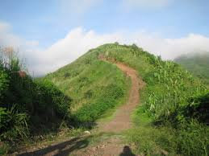
Is It an Adaptation?
An adaptation would be to take the nursery and make a film version of the story
No, this is Transmedia. Same world, different story
It tells the tragic story of what happened to the siblings after the infamous hill incident
A hill

Slide 30
Where’s the Father?
Jack and Jill break open their piggy bank and hire a private eye to find their father.
Maybe we can tell about the quest to find the father thusly…
We tell this story in a comic book, set in film noir style.

Slide 31
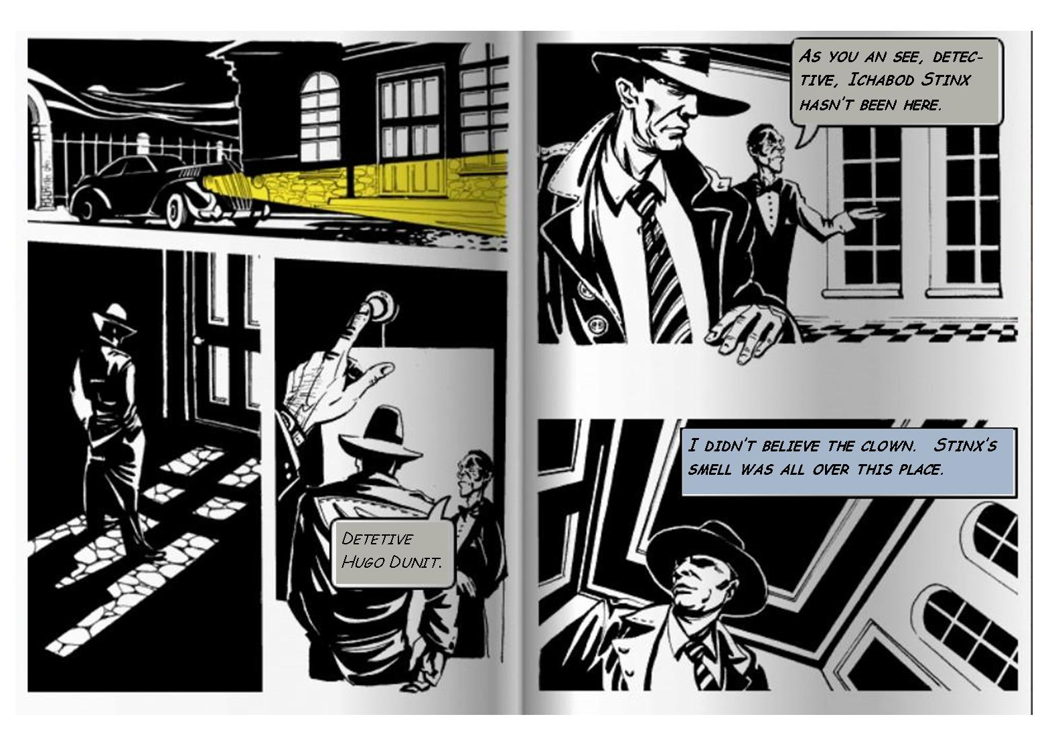

Slide 32
More of the World Can Be Told on…
Social Media Video
Graphic Novels
Comics
Animations

Slide 33
Even Alternate Reality Games
Audi’s “Art of the Heist”
Halo 2 – “I Love Bees”
Nine Inch Nails – “Year Zero”
“A-I: Artificial Intelligence”
Coke Cola

Slide 34
OF COURSE…
Remember, a transmedia storyworld is based upon your objectives…
Did the preceding storyworld deliver on the transmedia objective?

Slide 35
Transmedia is More Than a Marketing Gimmick
Even though film makers originally used transmedia as a marketing tool to increase movie revenues.
It can be – by itself – an immersive experience for people who want more of the world or mythology.
And, it has become a wonderful educational tools to generate more excitement, participation and immersion for students.

Slide 36
While it Can be Used to …
Build audience for Films, TV shows, even plays
It can stand on its own as a storytelling experience.
Enhance brand stories for products from Old Spice and Aflac to Coke and Gillette

Slide 37
And, it Delivers Greater Visibility
Transmedia allows your project to stay in front of your audience’s eyes and mind.

Slide 38
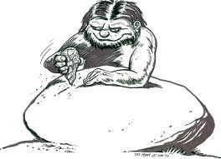
Significant Prior Art to Learn From
Martha: I swear, if you existed, I'd
divorce you.”
Wait till Ugga Bugga sees this.
This’ll make a great movie! I’ll call it
“Who’s Afraid of Virgina Woolf.”
People have been using media to tell stories for thousands of years.

Slide 39
Transmedia Moves into Television and Film
The World of Marvel uses Transmedia to build audience.
Check out the Transmedia applications for “Game of Thrones.”
Legos uses transmedia to market its movies…or, depending on your perspective, uses transmedia to market its Lego products…or, both.

